Slide 1
Exhibitor Kit

Slide 2
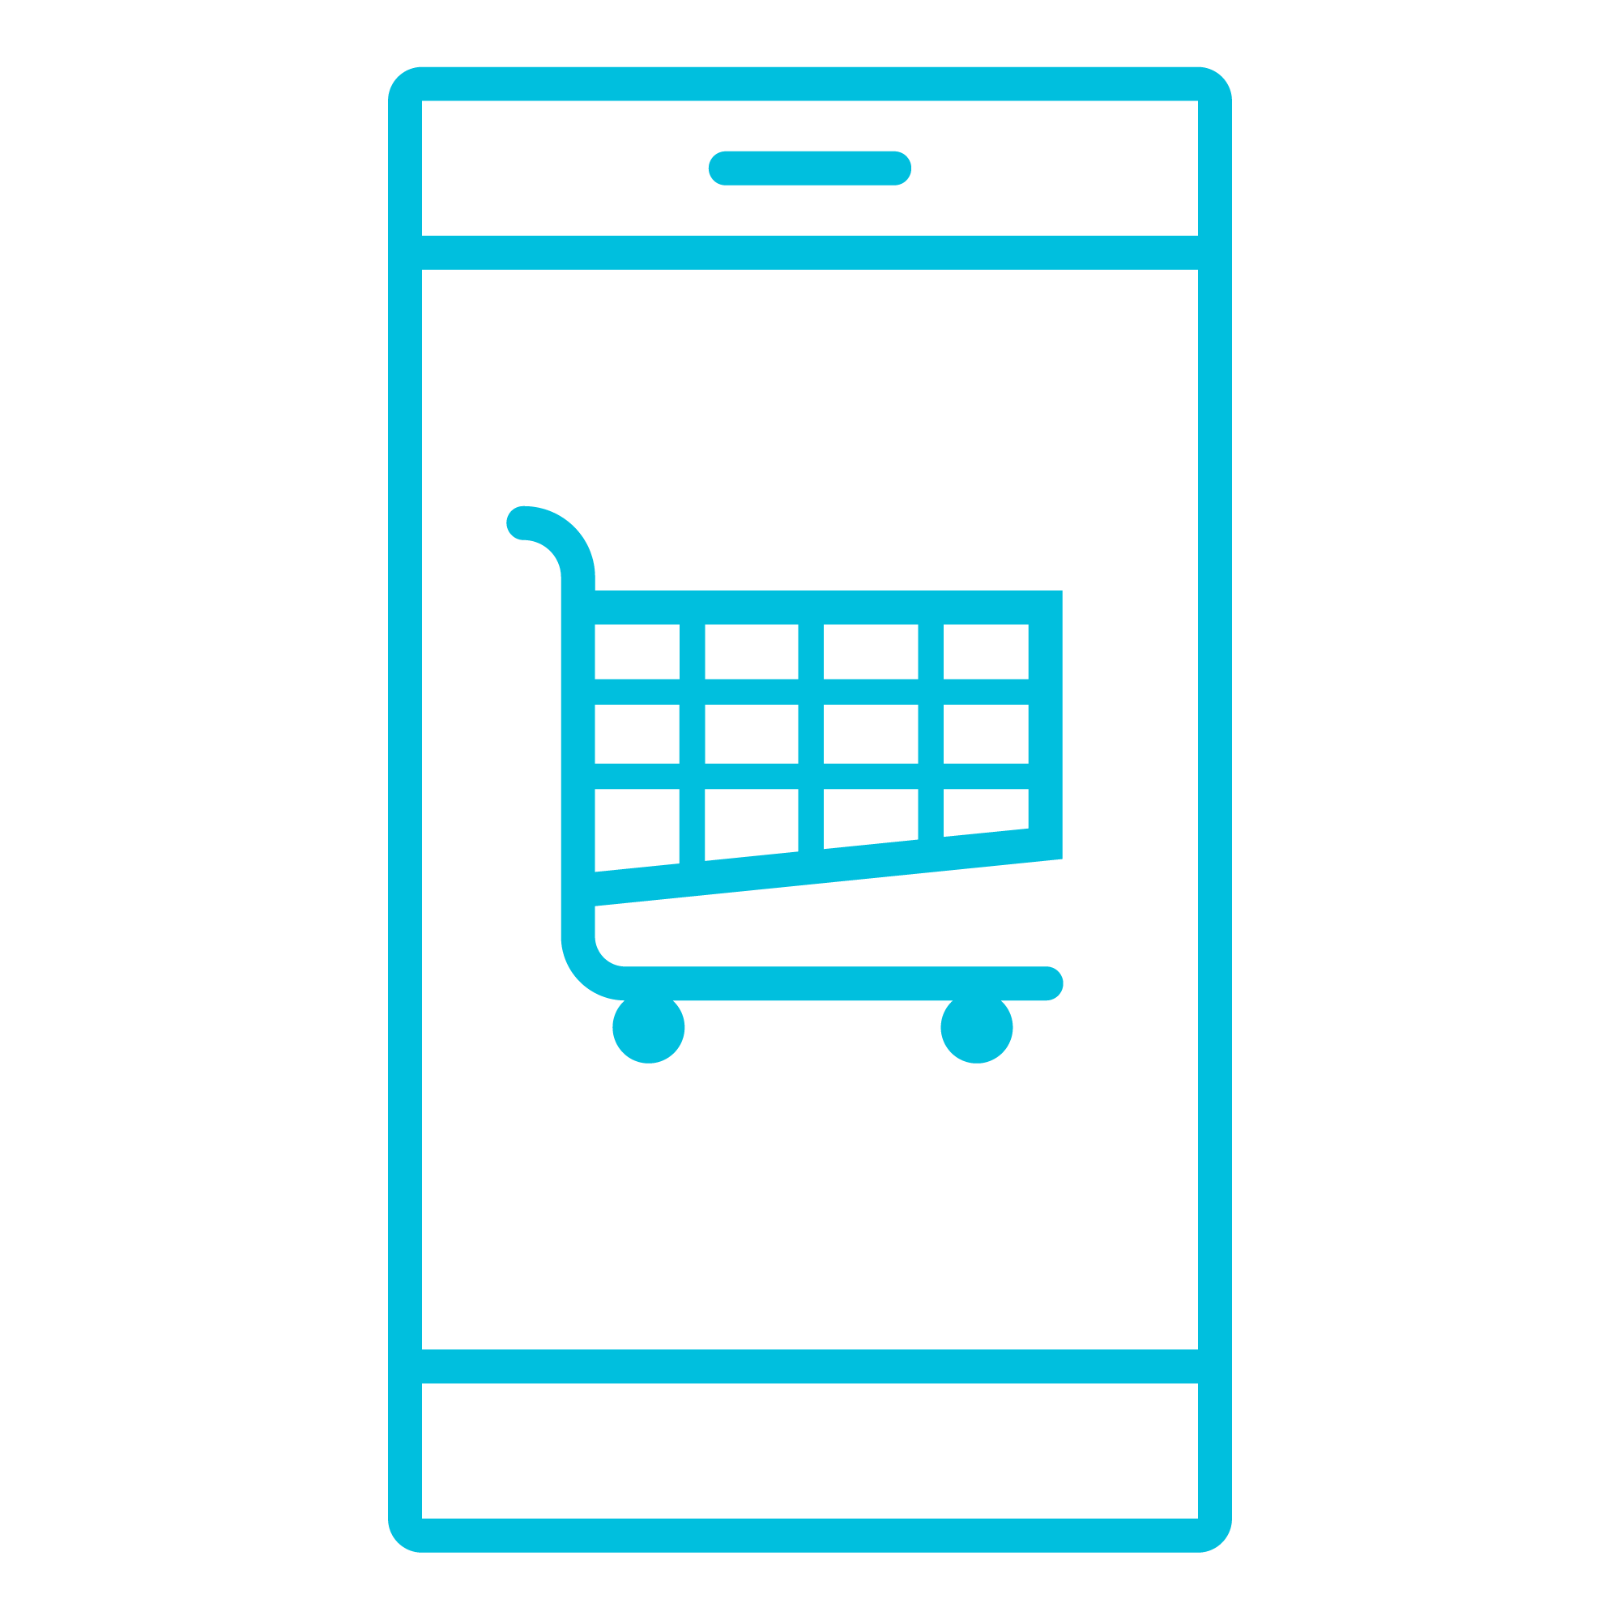
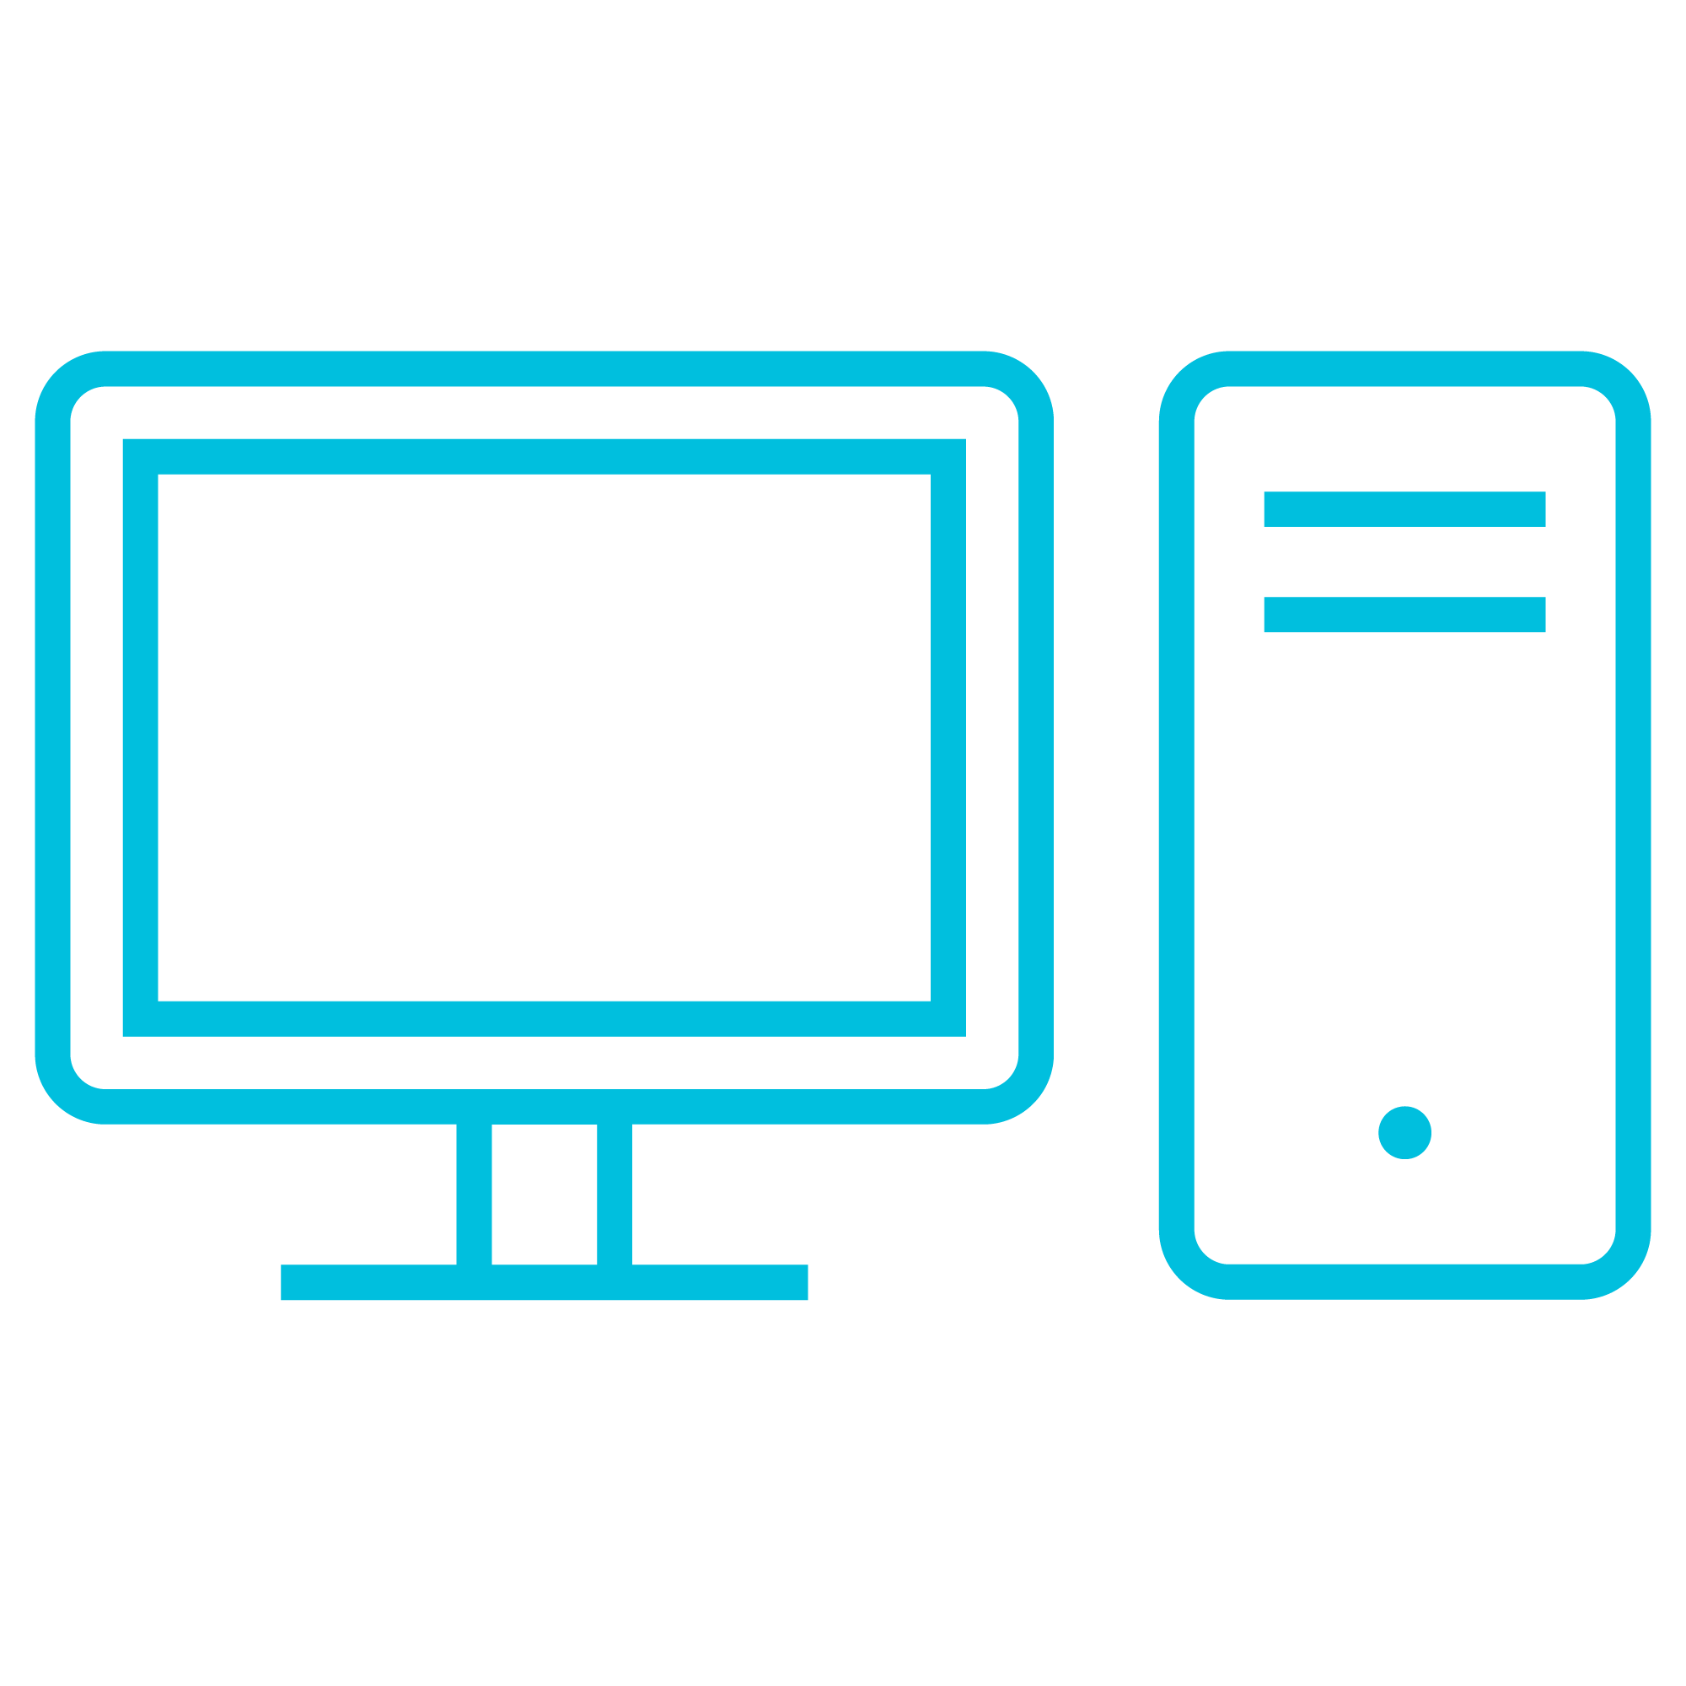
Easy Ordering
We make it easy
As the exclusive Technology Provider of Boston Park Plaza Encore is committed to making your experience as easy and stress-free as possible.
Easy ordering options
offers a range of solutions for any exhibitor:
As the exclusive Technology Provider of Boston Park Plaza Encore is committed to making your experience as easy and stress-free as possible.
Large and small format HD monitors (40” monitors and above include floor stands)
PC Based Laptops
Various Audio Packages
Wireless Presentation Controls
HDMI Cables, Distribution Amplifiers, and Adapters
LED Lighting
Flipchart Packages
Internet Connectivity Packages
Power Strip & Extension Packages
Confirmation email is sent with your order details
Self-service option available through our online store – EventNow
We regularly maintain and service all equipment
Step 1
Visit EventNow and select your show
Step 2
Browse our technology catalog
Step 3
Select from a list of available products/product packages and service packages, then check out.*
Encore delivers, installs, and tests equipment
After the show, Encore picks up your rental equipment
Need assistance or products/solutions not offered in EventNow?
EventNow is only available more than two days prior to event load in. If ordering within two days, contact your Encore on-site team.
Call your Encore on-site contact directly:
Once your order is completed, a confirmation email will be sent with all your order details and a dedicated professional will still be on-hand to answer any questions regarding your order.
NEED RIGGING
Nina D’Elia
Senior Sales Manager
Nina.d’elia@encoreglobal.com
If so, please fill out rigging request, https://www.encoreglobal.com/rigging-request/
Encore representative will be in touch with you.
©2022 Encore Global LP or its subsidiaries. Proprietary and Confidential Information.

Slide 3
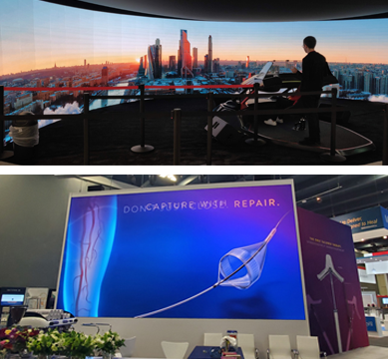
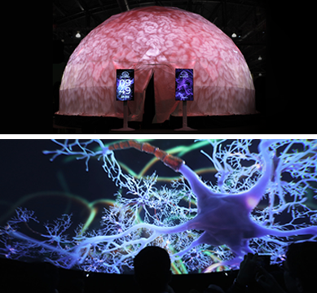
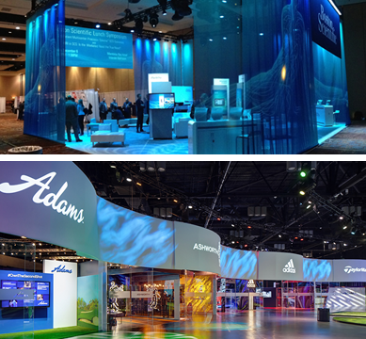
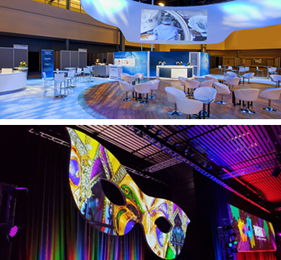
What else can we do?
^{Experiential Exhibits}
^{Led Walls}
^{Lighting Solutions}
^{Projection}
^{Video Solutions}
^{And More!}

